Slide 1









audiobooks
an Amazon company
@audibleanamazonconpany

Slide 2







About Us
About Us
Audible is the leading provider of audiobooks, podcasts, and spoken-word entertainment. Founded in 1995 and acquired by Amazon in 2008, Audible has transformed the way people read and listen to stories.

Slide 3


Vision
Vision
Mission
Mission
"To unlock the power of the spoken word and enrich lives through stories that inspire, entertain, and inform."
"To create and deliver the best audio content and listening experiences for our customers—anytime, anywhere."

Slide 4

Module 2 Case Study
Module 2 Case Study
Audible Data Cleaning Project
Audible Data Cleaning Project

Slide 5
Some fixes before starting project
Some fixes before starting project
Using first row as Headers

Slide 6
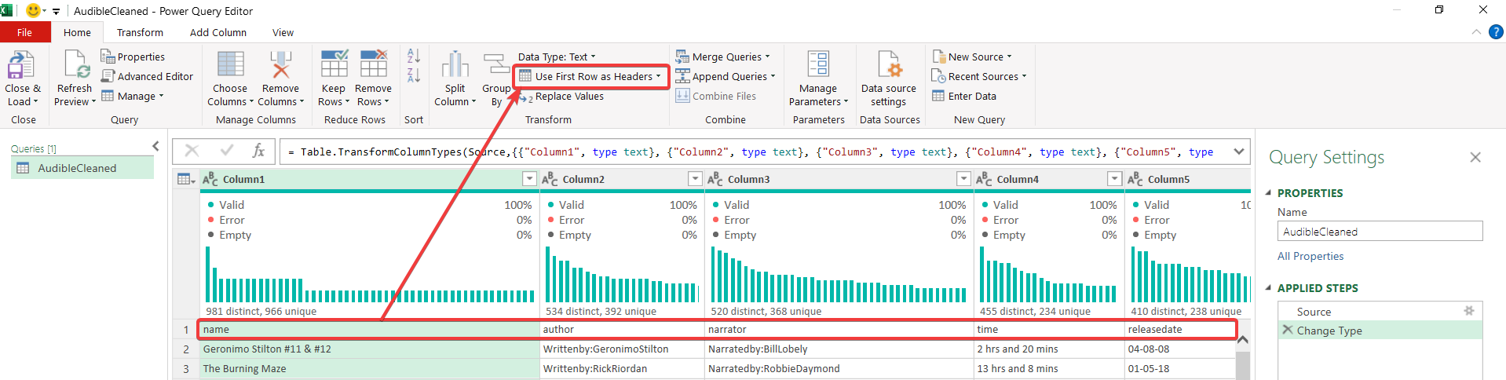
Step
Step

Slide 7
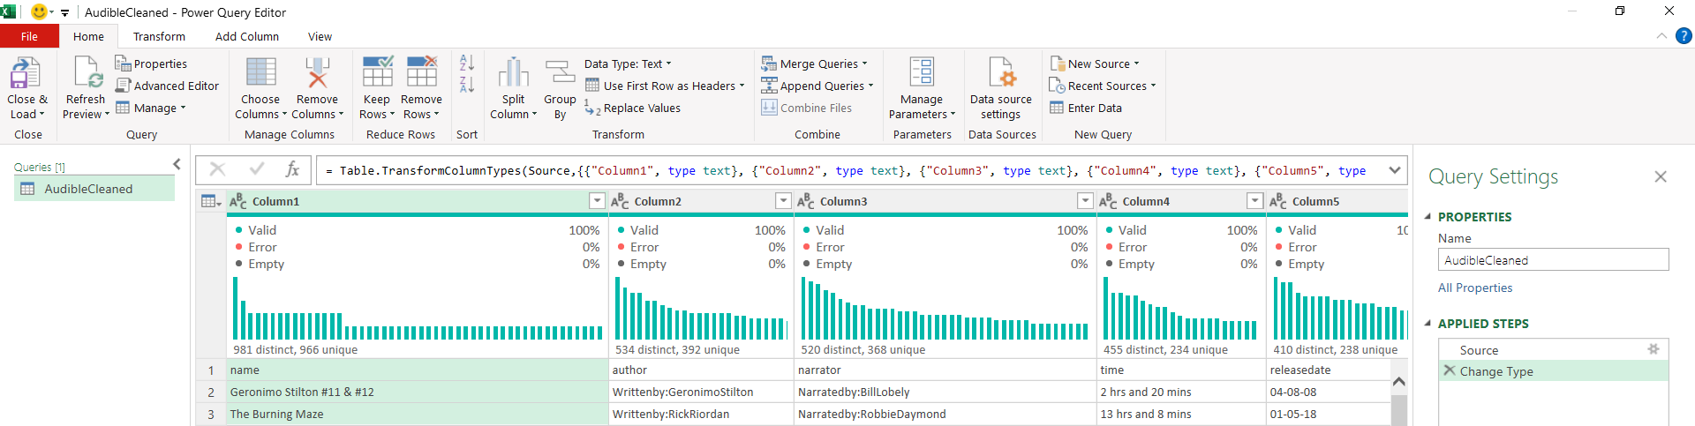
Before
Before

Slide 8
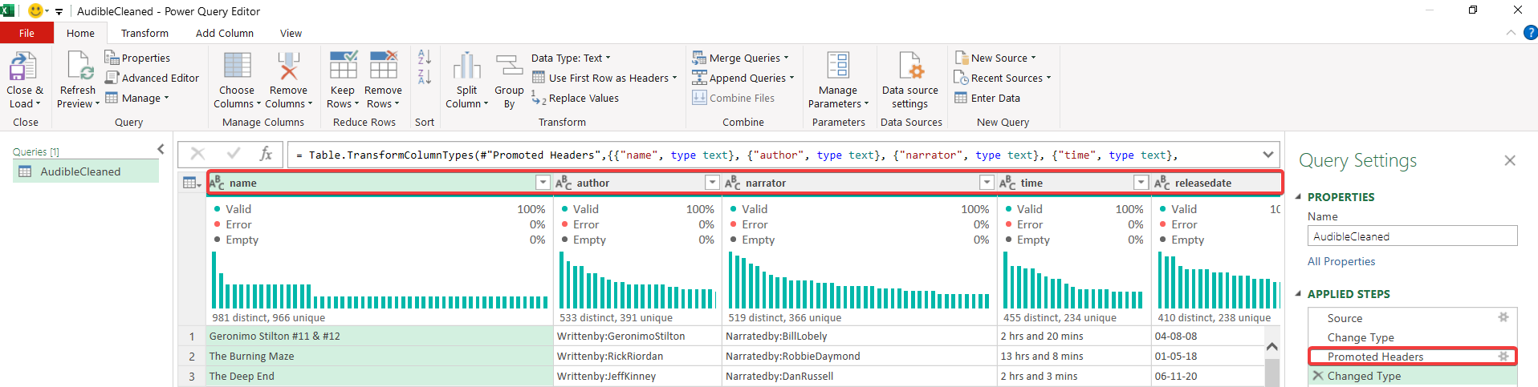
After
After

Slide 9


Project Questions
Project Questions
1.Standardize the name column to ensure consistent title casing.
2.Separate combined first and last names in the author column if they are currently combined.
3.Ensure all entries in the releasedate column follow a consistent date format (DD-MM-YYYY).
4.Convert the time column from text format to a duration format that Excel recognizes.
5.Ensure the price column is in a numeric format, and identify any non-numeric values.
6.Convert text ratings in the stars column to numeric values.
7.Split the narratedby column into multiple columns if multiple narrators are listed.
8.Merge the releasedate and language columns into a single new column named releaseinfo with the format "DD-MM-YYYY, Language."
9.Ensure all currency values in the price column are formatted consistently with two decimal places.

Slide 10
Question - 1
Question - 1
1.
Standardize the name column to ensure consistent title casing.

Slide 11
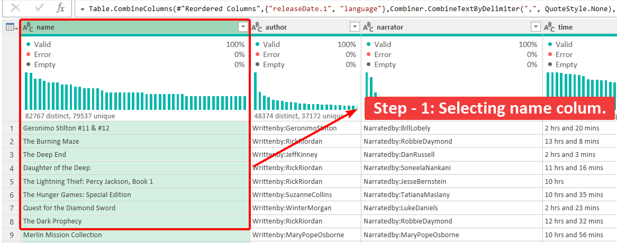

Step - 1
Step - 1
Select name column.
In step first , I selected the name column , so i can transform it .

Slide 12
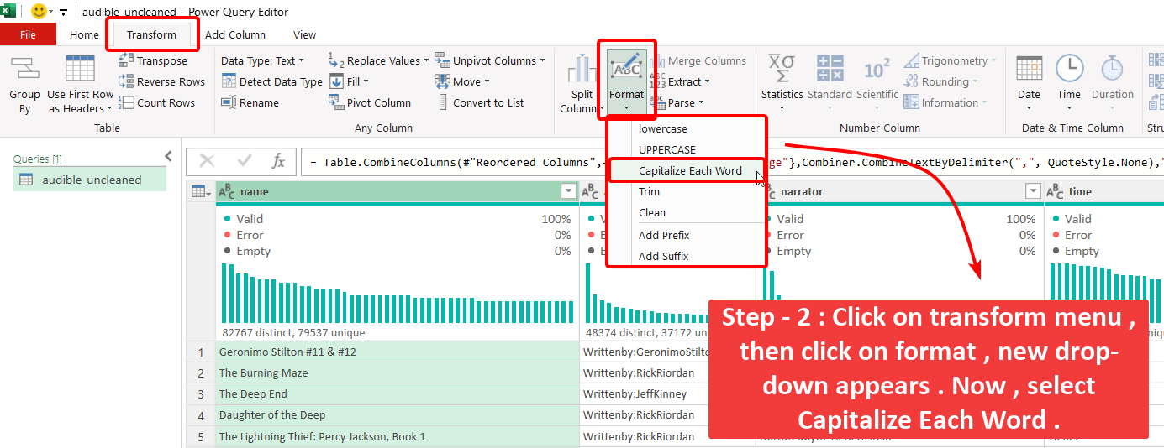
Step - 2
Step - 2
Transforming column
In step second , I transformed column using Capitalize Each Word .

Slide 13
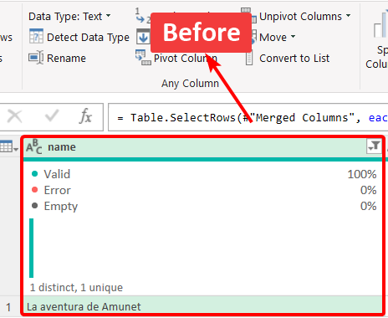
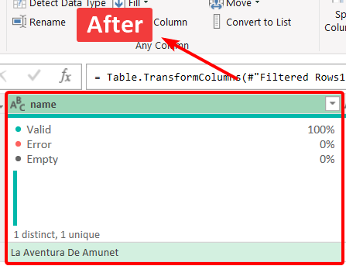
Result
Result
Before & After Comparision

Slide 14
Question - 2
Question - 2
2.
Separate combined first and last names in the author column if they are currently combined.

Slide 15

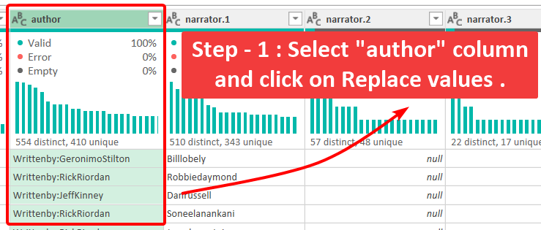
Step - 1
Select “author” column
Step - 1
In step first , I selected the author column .

Slide 16
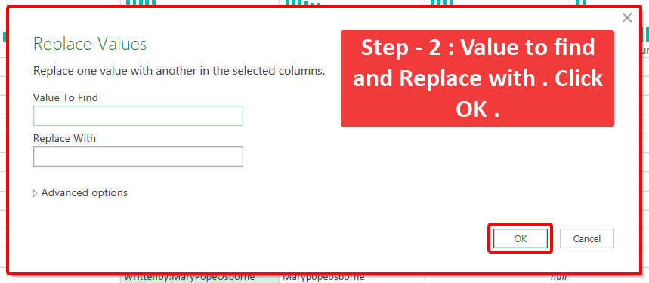
Step - 2
Step - 2
Replace values
i have repeateed this step 8 times .
Replace values ----- With
“Writtenby:” ----- “”
“,” ----- “ “
“,” ----- “ “
“-” ----- “ ”
“777” ----- ““
“eOne” ----- ““
“...” ----- ““
“div” ----- ““

Slide 17
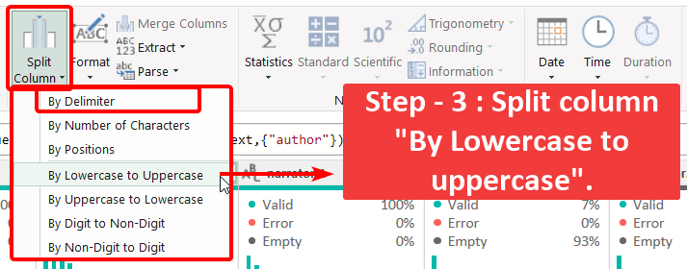
Step - 3
Step - 3
Split column using “By Lowercase to uppercase”
In step first , I splitted column using “By Lowercase to uppercase” .

Slide 18
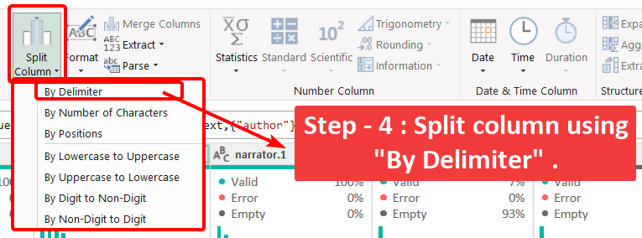
Step - 4
Split column using “By Delimiter”
Step - 4
In this step , I splitted column using “By delimiter” .

Slide 19
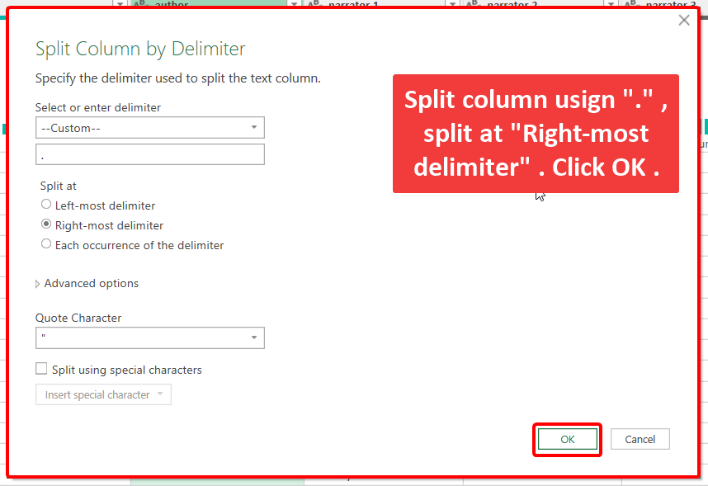
Step - 4
Split column using “By Delimiter”
Step - 4
In this step , I splitted column using “.” from “Right most side” as “By delimiter” .

Slide 20
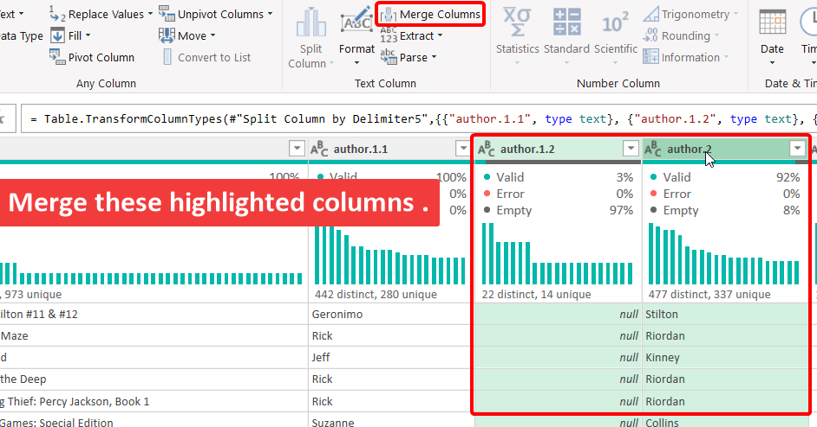
Step - 5
Merge columns
Step - 5
In this step , I merged the columns highlighted in the image .

Slide 21
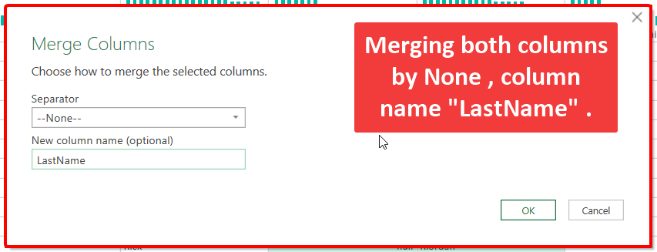
Step - 6
Step - 6
Merge columns and rename it to LastName
In this step , I merged the columns highlighted with “None” and rename column to “LastName” .

Slide 22
Question - 3
Question - 3
3.
Ensure all entries in the releasedate column follow a consistent date format (DD-MM-YYYY).

Slide 23
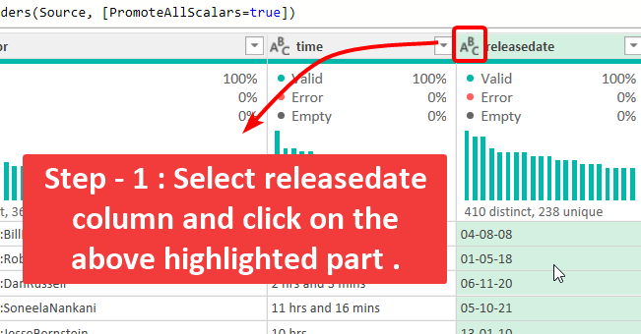

Step - 1
Step - 1
Select Release column
In step first , I selected the release column .

Slide 24
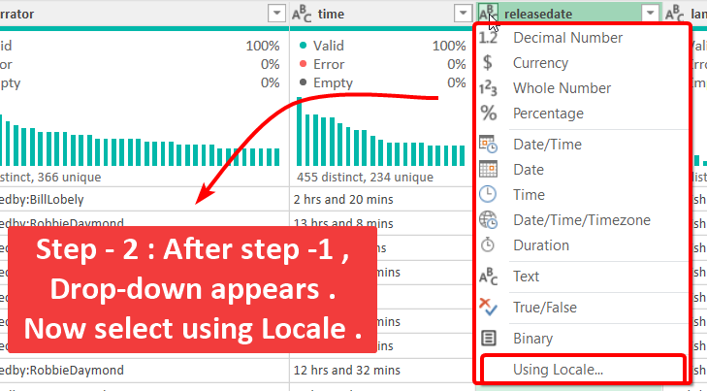
Step - 2
Step - 2
Formatting Date format using Locale
In step second , Select Locale to change date format.

Slide 25
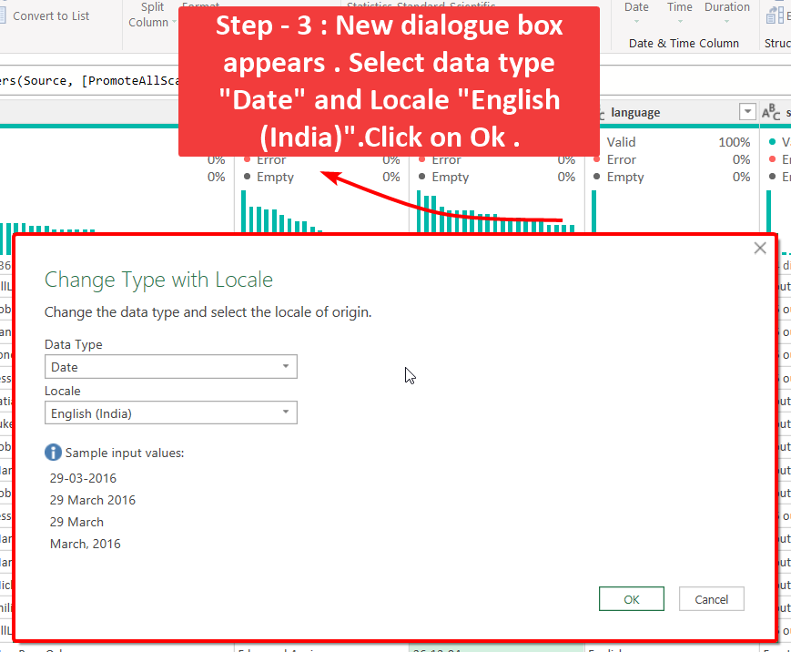
Step - 3
Change Data type
Step - 3
In this step , I changed data type to date format.

Slide 26
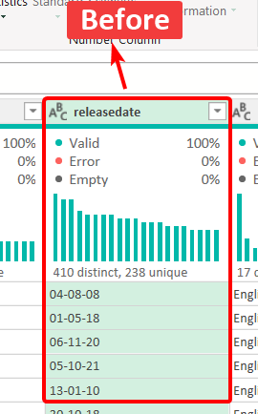
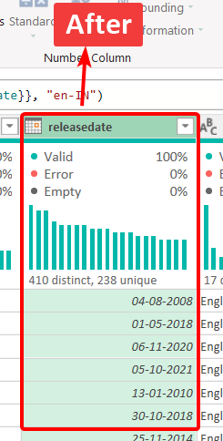
Result
Result
Before & After Comparision

Slide 27
Question - 4
Question - 4
4.
Convert the time column from text format to a duration format that Excel recognizes.

Slide 28
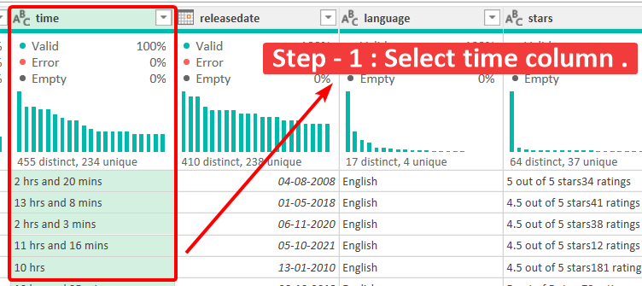
Step - 1
Step - 1
Select time column.
In first step , Select column to perform transformation.

Slide 29
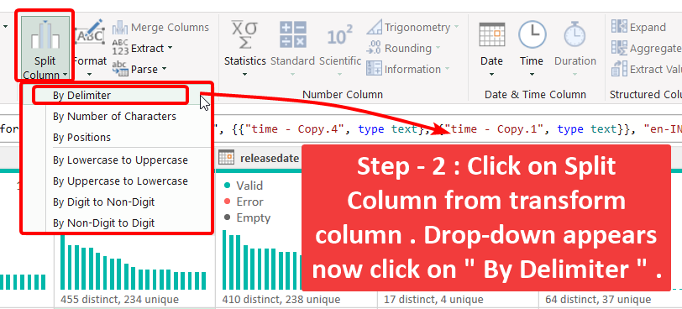
Step - 2
Step - 2
Separate column using delimiter
In this step , Select column and use By delimiter fromdrop-down to split column.

Slide 30
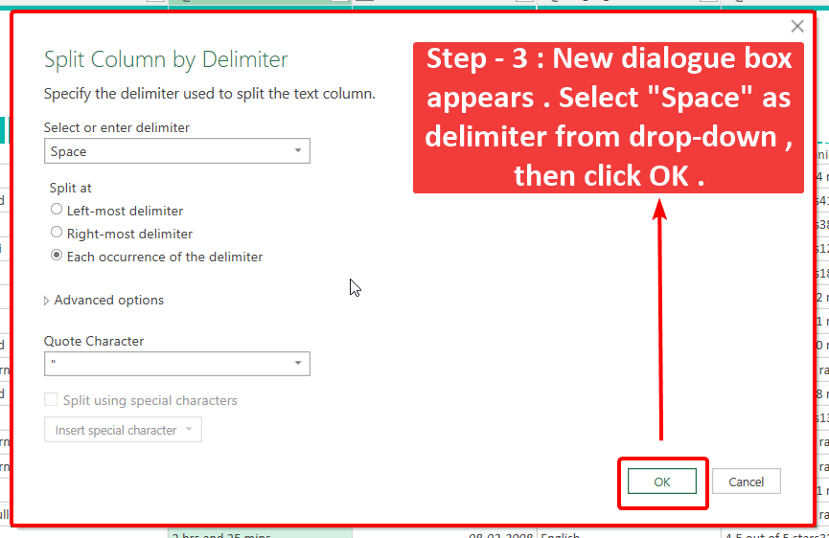
Step - 3
Step - 3
Separate column using delimiter with “Space”
In this step , Select “Spcae” delimiter to split column.

Slide 31
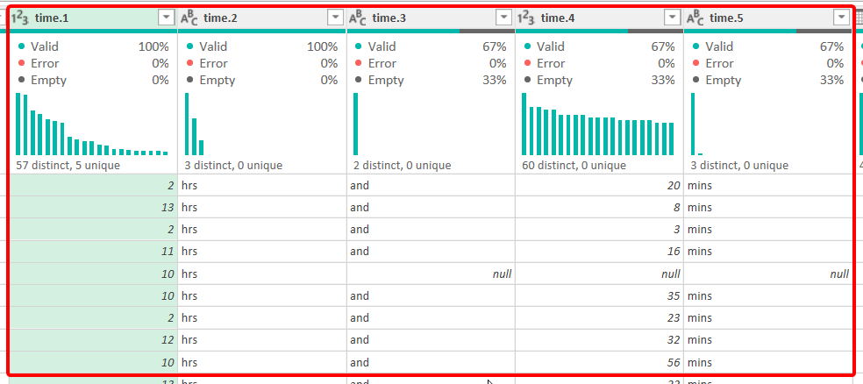
Step - 3 result
In this step , time column splitted in new 5 columsn, remove unneccesary columns.

Slide 32
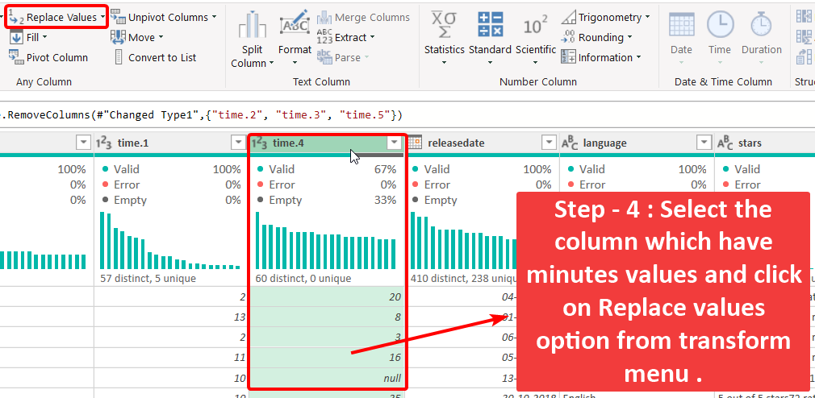
Step - 4
Step - 4
Replace null with 00/zeros
In this step , Select minute column to replace null values with 00.

Slide 33
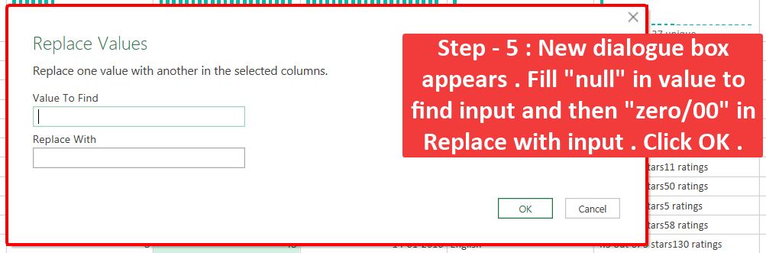
Step - 5
Step - 5
Replace null with 00/zeros
In this step , replace null values with 00.

Slide 34
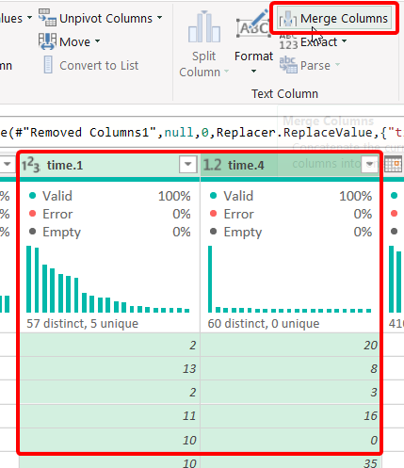
Step - 6
Step - 6
Select both column to merge
In this step , Select column to merge them.

Slide 35
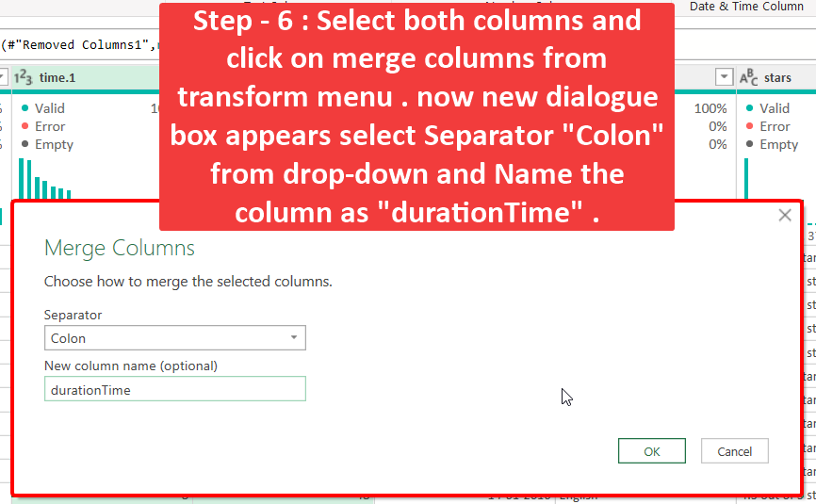
Step - 6
Step - 6
Select both column to merge
In this step , Select “Colon” from separator , name new column.

Slide 36
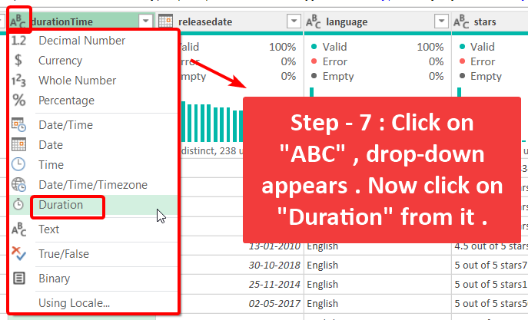
Step - 7
Step - 7
Change data type to “duration”
In this step , Select “Colo” from separator , name new column.

Slide 37
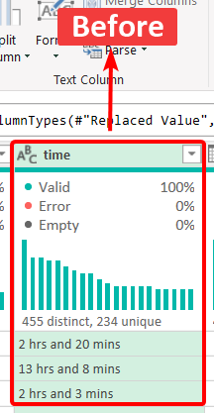
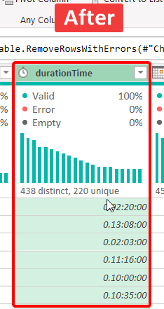
Result
Result
Before & After Comparision

Slide 38
Question - 5
Question - 5
5.
Ensure the price column is in a numeric format, and identify any non-numeric values.

Slide 39
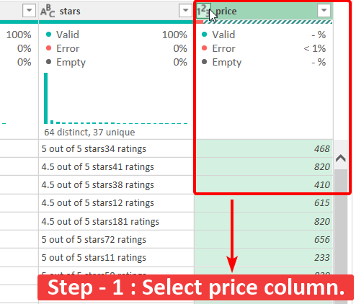

Step - 1
Step - 1
Select price column.
In step first , I selected the price column , so i can transform it .

Slide 40
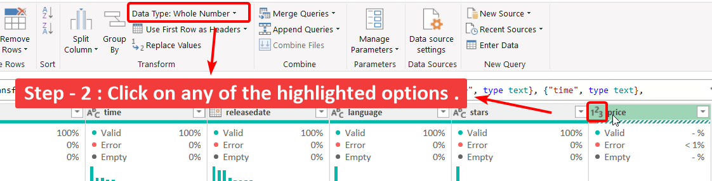
Step - 2
option (a) → Click on Data type from Home menu.
option (b) → Click on 123 as highlighted.
Step - 2

Slide 41
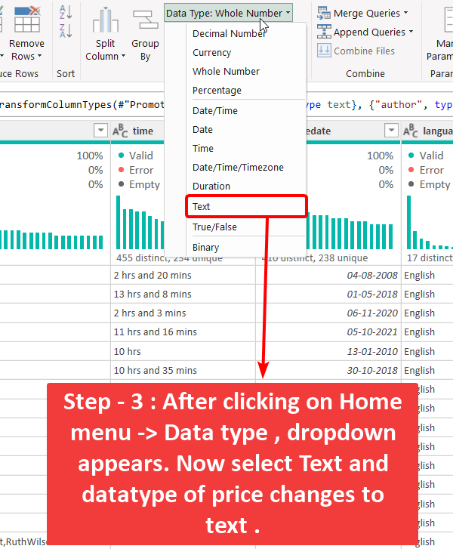
Step - 3
Step - 3
option (a)
Select text from drop-down.

Slide 42
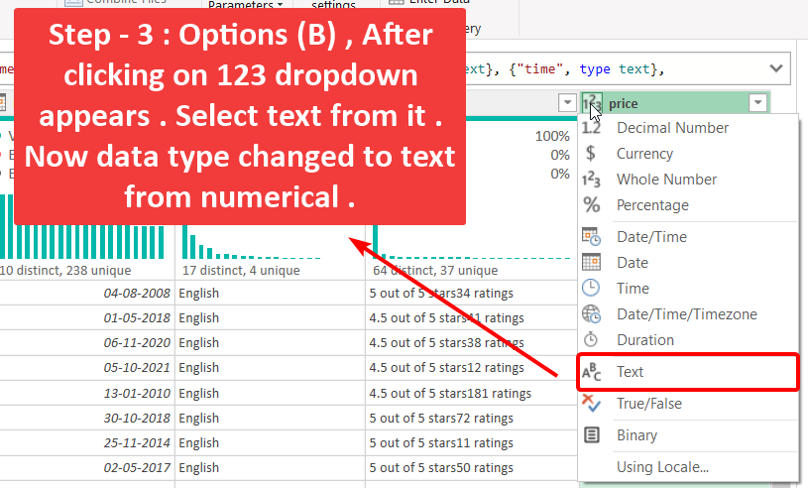
Step - 3
Step - 3
option (b)
Select text from drop-down.

Slide 43
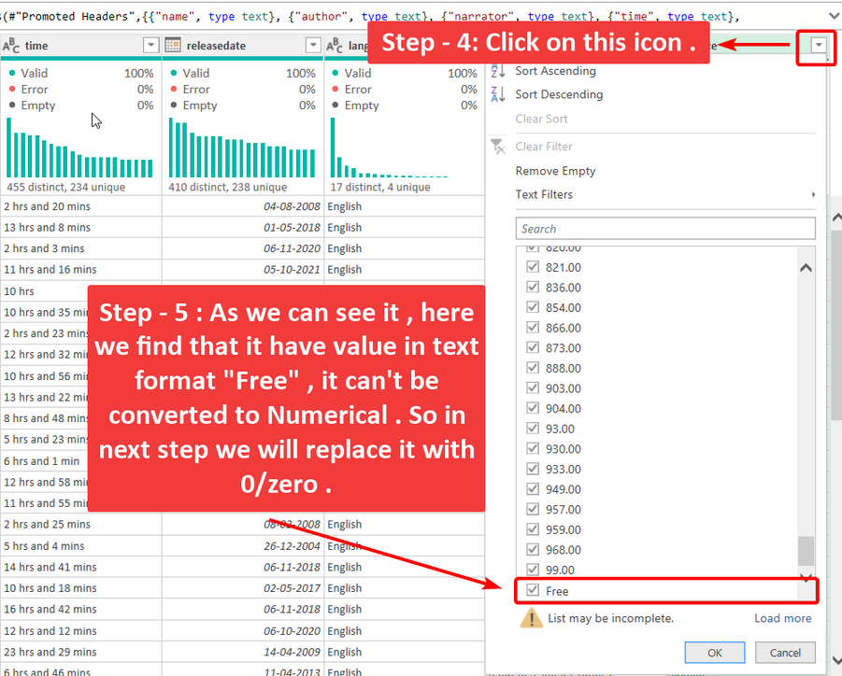
Step - 4 & 5
Checking values
Step - 4 & 5
Here , we find that it have text in some rows as values .

Slide 44
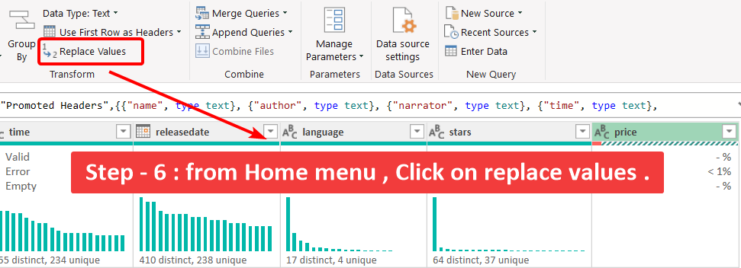
Step - 6
Step - 6
Replace values
Click on replace vlaues to replace values from column.

Slide 45
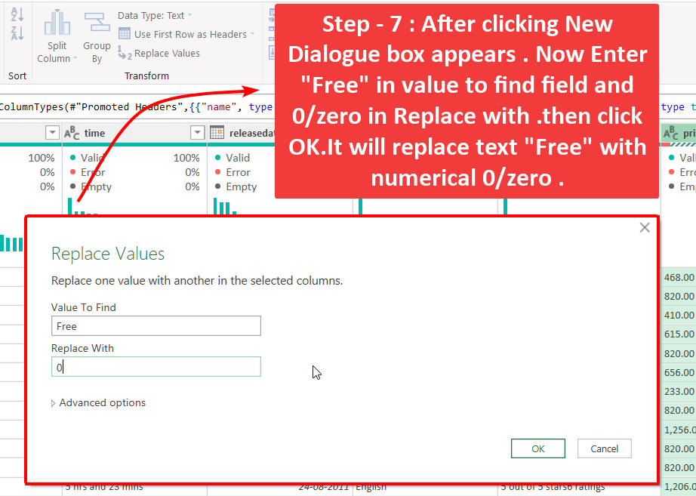
Step - 7
Step - 7
Replace values
After click on replace values , new dialogue box appears. Now replace “Free” with 0/Zero .

Slide 46
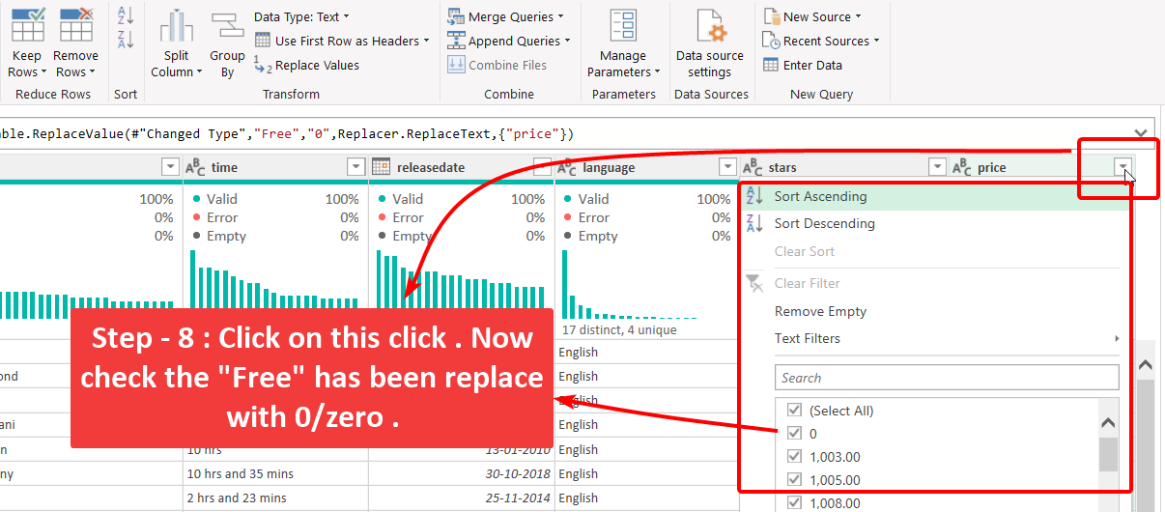
Step - 8
Step - 8
Check values replaced or not .
Here , we checked that the value “Free” is replace with 0/zero or not .

Slide 47
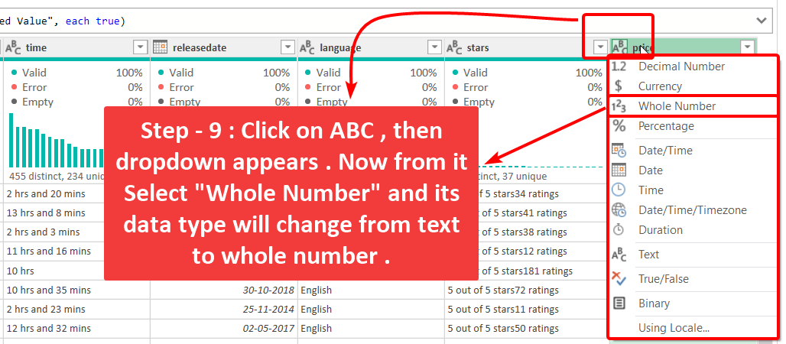
Step - 9
Step - 9
Change data type from Text to While Number.
Select “Whole Number” from drop-down to change data type of the column.

Slide 48
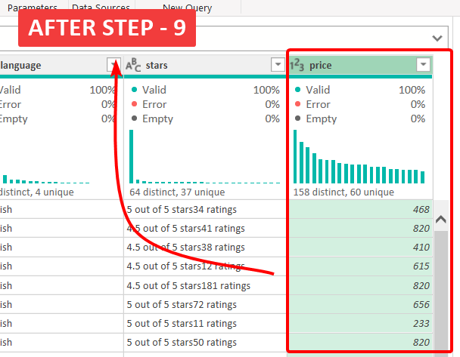
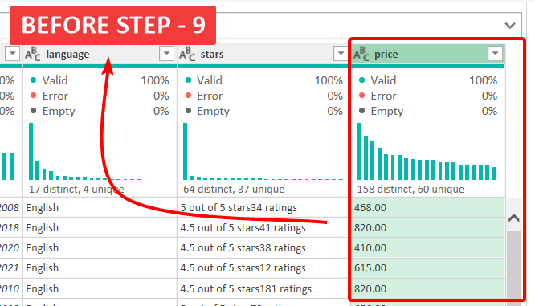
Result
Result
Result
Here we can see the difference , when it was in Text Format then it was in Left Side , but after changing its data type it Shifted to Right Side .

Slide 49
Question - 6
Question - 6
6.
Convert text ratings in the stars column to numeric values.

Slide 50
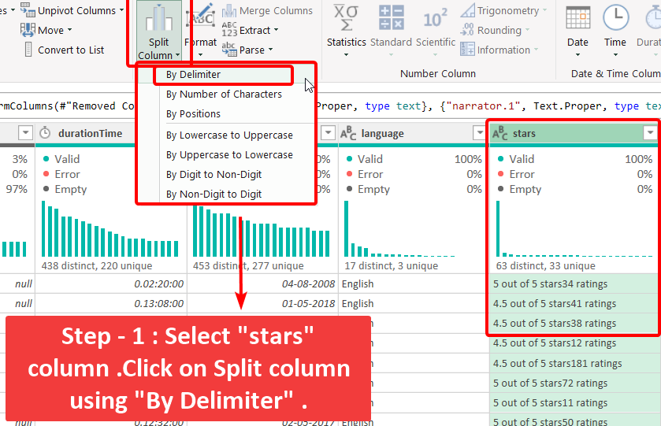

Step - 1
Step - 1
Select stars column
Select column and click on split colum usign by delimiter.

Slide 51
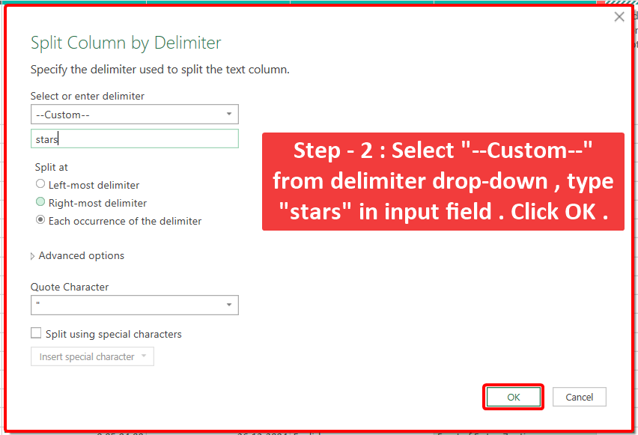
Step - 2
Step - 2
Splitting column
Select delimiter “stars” by delimiter.

Slide 52
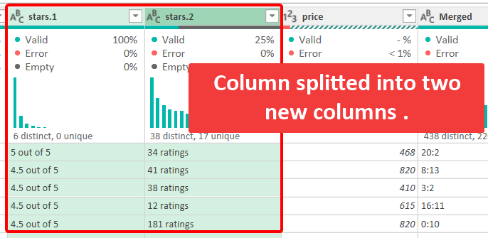
Step - 2
Step - 2
Rating column formed
New columns formed.

Slide 53
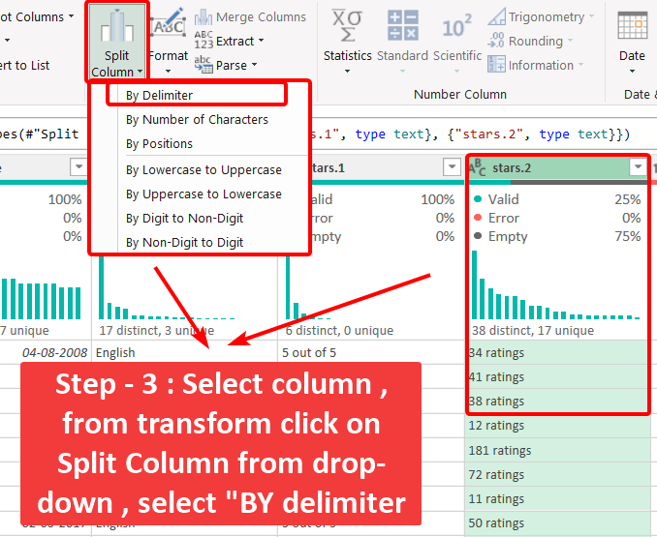
Step - 3
Step - 3
Split column once again
Split columns once again.

Slide 54
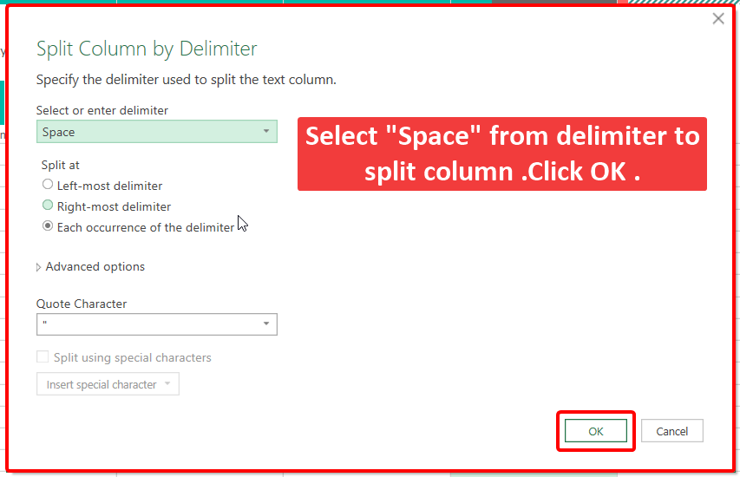
Step - 3
Step - 3
Split column “Space” delimiter
Split columns on “Space” using Delimiter .

Slide 55
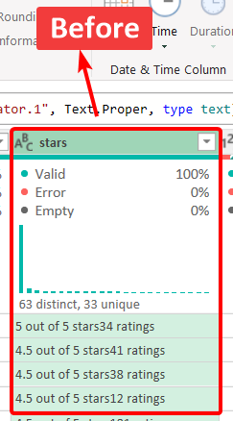
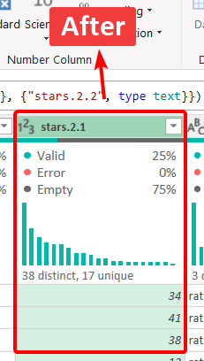
Result
Result
Result

Slide 56
Question - 7
Question - 7
7.
Split the narratedby column into multiple columns if multiple narrators are listed.

Slide 57
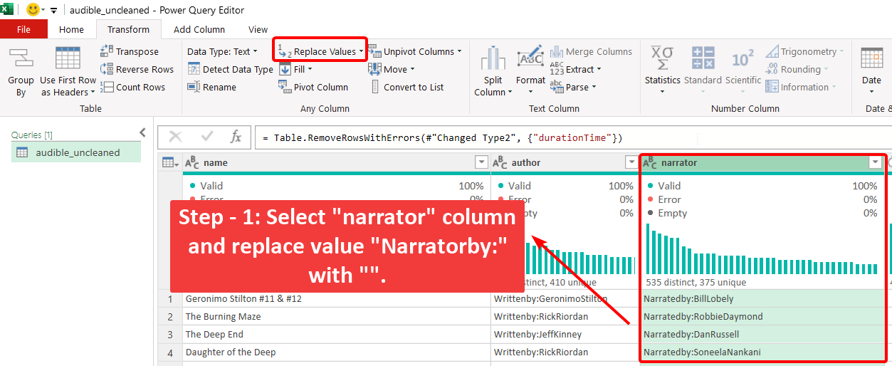
Step - 1
Step - 1
Select narrator column & replace values
Select column and replace “Narratorby:” with “”.

Slide 58
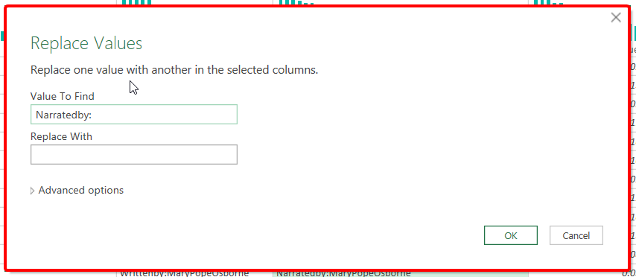
Step - 1
Step - 1
Select narrator column & replace values
Replacec values “Narratedby:” with “”.

Slide 59

Step - 2
Step - 2
Split columns by Delimiter
Split column using By delimiter

Slide 60

Step - 2
Step - 2
Split columns by Delimiter
Split column using “Comma” By delimiter .

Slide 61

Step - 2
Step - 2
New columns
New columns created.

Slide 62


Result
Result
Result
You can see final reseutl.

Slide 63
Question - 8
Question - 8
8.
Merge the releasedate and language columns into a single new column named releaseinfo with the format "DD-MM-YYYY, Language."

Slide 64


Step - 1 & 2
Transform column
Step - 1 & 2
In step first , I selected the language column , so i can transform it usign format inside it.

Slide 65

Step - 3
Step - 3
Formatting with Capitalize each Word.
In this step , formatting languege column values.

Slide 66

Step - 4
Step - 4
Checking Formated Values.
In this step , formatting languege column values.

Slide 67
Step - 5
Step - 5
Column selection
In this step , formatting languege column values.

Slide 68
Question - 9
Question - 9
9.
Ensure all currency values in the price column are formatted consistently with two decimal places.

Slide 69

Step - 1
Transform column
Step - 1
In step first , I selected the column , so i can change its data type to “text”.

Slide 70

Step - 1
Step - 1
Replace values
In this step , I replace values “Free” with 0/zero.

Slide 71

Step - 2
Step - 2
Data type change
In this step , I changed data type to “Currency”.

Slide 72


Result
Result
Result
You can see final reseutl.

Slide 73


Thank You
Contact : farookmohammad27@gmail.com
@farookmohammad

